Slide 1
CheMin
Group-2
Poonam Lakhangaonkar
Hiren Patel
Valentin BERTHOMIER
Rajnish Kumar

Slide 2
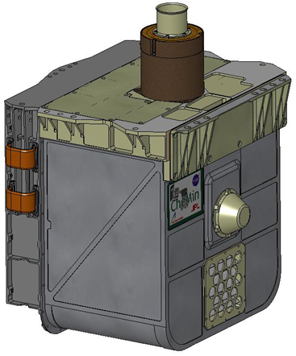
Introduction
CheMin is a mineralogy instrument that will identify and quantify the minerals present in rocks and soil powder samples delivered by the rover's robotic arm

Slide 3
Description
CheMin Instrument is located inside the main body of the rover
CheMin Uses
A technique called X-ray diffraction (XRD) for mineralogy characterization
X-ray fluorescence (XRF) for elemental characterization
A single detector for both measurements
One moving part (Sample wheel)

Slide 4
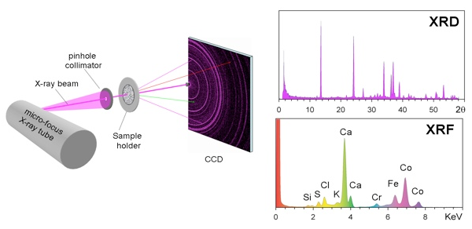
(CheMin XRD/XRF instrument )

Slide 5
What CheMin does?
CheMin analyze the sample delivered to it by SA/SPaH
It identifies the minerals present in Mars soil & rocks
Mineralogy helps CheMin to assess the involvement of water in their formation, position and alteration
CheMin data is useful in the search for potential mineral energy sources for life or indicators for past habitable environments

Slide 6
CheMin Requirements
Power Requirements
Chemin require 250W-hr power per evening for processing.
CheMin is limited to approximately 4 hours of analysis per evening of operation, with the remaining energy allocated for pre-analysis warm-up of the X-ray source, and post-analysis data processing and transfer.
The complete analysis of any one sample can take up to 10 hours, thus requiring multiple evenings to analyze a sample.

Slide 7
CheMin components
Funnel
Receives drill powders or scoop samples from the SA/SPaH system
Maximum of 65 mm³ of sample material is delivered
It contains a 1-mm mesh screen to keep larger than expected grains from entering the CheMin sample handling system
Grains that pass through the screen will pass into the upper reservoir portion of the sample cell
CheMin may reduce contamination by sample dilution

Slide 8
CheMin components
Sample cell and sample wheel
Carries 27 reusable sample cells and 5 permanent reference standards
Only 10 mm^3 material is required to fill the sample cell
Remaining sample goes to reservoir (which is above cell)
During filling, analysis, and dumping, the sample cell is shaken by piezoelectric actuators (piezos)

Slide 9
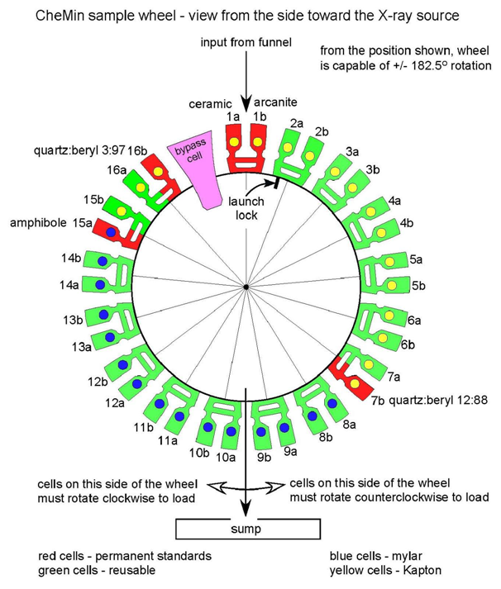
(Sample Wheel And Sample cell)

Slide 10
CheMin components
X-Ray Beam
X-ray beam from the X-ray tube is directed through a transmission sample cell containing sample
X-ray sensitive CCD imager is positioned on the opposite side of the sample from the source
X-ray diffraction occurs with the crystal material and form the rings i.e. a two-dimensional image that constitutes the diffraction pattern

Slide 11
CheMin Process
CONFIG PHASE
Position the X-ray sensitive CDD imager
Receive drilled powder through the drill, scoop and CHIMRA sorting assembly

Slide 12
CheMin Process
FILLING PHASE
Open chemin inlet protection cover
16 dual cells on the sample wheel -> 1piezzo for each dual cell
piezzo is active during filling analysis and dumping
Turn on piezzoelectric actuators number X
put sample in the funnel
Close inlet protection cover
If received sample contains more than 5% of contamination then sample rejected

Slide 13
CheMin Process
ANALYSIS PHASE
Turn on X-ray beam
CDD reads out and erase the X-ray flux multiple times (+1000times) for analysis
Data handling
Identify energy of X-rays strikes by the detector and produce 2D image of diffraction pattern
Sum all the X-ray detected by CDD into a histogram of number of photon Vs photon NRJ
Sum the 2D pattern circumferentially about the central non-diffracted beam to create a 1D 2theta plot

Slide 14
CheMin Process
DUMPING PHASE
Rotate the sample wheel 180⁰ (sample cell inversion)
Empty the cell after use by inverting and vibrating the sample cell over the sump
Rotate back to the next sample slot
Rotate the sample wheel 180⁰-X (X corresponds to the distance between sample cells)
Turn off piezzo

Slide 15
CheMin Commands
chemin on: start the chemin process
xray_set_ position:set the xray position towards sample
sample_receive:this message from telecommunication module
cell _next:from the sample
cell_clean_current:dump the sample
inlet_open:open the
inlet_close:

Slide 16
CheMin Commands
xray_turn_on: turn on the x-ray beam
analysis_start:start analysis on sample
cdd_create_diffreaction_image:
cdd_create_1d_2t_plot:
send_result:send result to telecommunication server
power_off:turn off the chemin and terminate the process.

Slide 17
Code Explanation
SimulateRoverMain
Module creation
CheMinModuleMain
Power Server
Telecom Server
Module launching
CheMinModuleMain is launched
Threads for CheMin server and CheMin process are created & started
Server threads for Power and Telecom are created & started

Slide 18
Code Explanation
CheMin server
If message is ‘chemin_on’
Set CCU to true and create CheminClient(9013->power) thread and start it
If message is ‘power on’
Launch chemin process create CheminClient(9002->Telecom) thread and start it
If message is ‘Power Off’
Then free Chemin threads

Slide 19
Code Explanation
CheMin Client
If port is 9013
PowerRequirement is sent to PowerClient
If port is 9002
XrdDiffraction image is sent to TelecomClient

Slide 20
Code Explanation
CheMin Process - can receive the text file which contains the commands to execute
f_xray_set_position()
set and configure x-ray beam position
f_sample_receive()
launch the powder sample receiving procedure
If inlet cover is opened, abort the operation

Slide 21
Code Explanation
f_cell_go_to(5)
Choose the sample cell (depending on given sample cell number and current sample cell)
f_cell_clean_current()
Start the cleaning procedure
f_inlet_open()
Open inlet cover if not opened already

Slide 22
Code Explanation
f_piezzo_tun_on(v_current_sample_cell/2)
Turn on the given piezzo if not on
f_inlet_close()
Close inlet cover if not closed already
f_piezzo_turn_off(v_current_sample_cell/2)
Turn off the given piezzo if not off
f_xray_turn_on()
Turn x-ray on

Slide 23
Code Explanation
f_analysis_start()
Verify that every component is ready to start analysis phase
X-ray position
X-ray on
Inlet cover closed
Sample cell contamination checked
Sample not contaminated
If all above checks satisfied then turn off piezzo

Slide 24
Code Explanation
f_analysis_start()
Starts analysis // not clear with this
play music ‘voice.mp3’
f_cdd_read_erase()

Slide 25
Code Explanation
f_cdd_create_diffraction_image()
Create diffraction image
f_cdd_create_1d_2t_plot()
Create 1D 2theta plot image
f_send_results()
End of process, send results to telecom

Slide 26
Code Explanation
Power Server
Waits for client message
If receive message, print it
then create power client(9008->CheminServer) thread and start it

Slide 27
Code Explanation
Power Client
Print socket port
If socket port is 9008
then send "POWER ON" to port 9008 (to Chemin Server)

Slide 28
Code Explanation
Telecom Server
Waits for client message
If receive message print it
then create telecom client(9008->CheminServer) thread and start it

Slide 29
Code Explanation
Telecom Client
Print socket port
If socket port is 9008
then send "Chemin receives telecom acknowledge" to port 9008 (to Chemin Server)

